Slide 1

Weather Dashboard
Created by
Neil Cardoz (23070126079)
Nimit Prakash (23070126082)
Ranveer Singh (23070126102)

Slide 2

Introduction:
Weather Analytics
Weather analytics helps in predicting and preparing for extreme weather events such as hurricanes, tornadoes, floods, and heatwaves, thereby enabling authorities to implement preventive measures and mitigate risks to human life and infrastructure. With the advent of advanced technologies like artificial intelligence and machine learning, weather analytics continues to evolve, offering more accurate forecasts and enhancing our understanding of the complex dynamics of the Earth's atmosphere.

Slide 3
Objectives
Fabricate a Dashboard:
Analyze Data:
Personalized Recommendations:
Understand the working and functionality of analytics by implementing different plots with real time data
Understand the tends of different weather parameters and display their graphs. Calculate their summary statistics
Show all the data is an beautiful Graphical Interface
Based on the historical weather data, the app provides personalized recommendations to help users make the most of the present conditions. These tailored suggestions can range from outdoor activity planning to wardrobe choices, ensuring users are well-prepared for the weather ahead.

Slide 4




OBJECTIVES
Personalized Location
Detailed Visualizations
Personalized Recommendations
Informed Decision-Making
Explore weather data tailored to your specific location or multiple locations of interest.
Gain a comprehensive understanding of weather patterns through interactive graphs and charts.
Receive tailored suggestions to help you make the most of the upcoming weather conditions.
Leverage the app's weather insights to make informed decisions for your personal and professional needs.

Slide 5
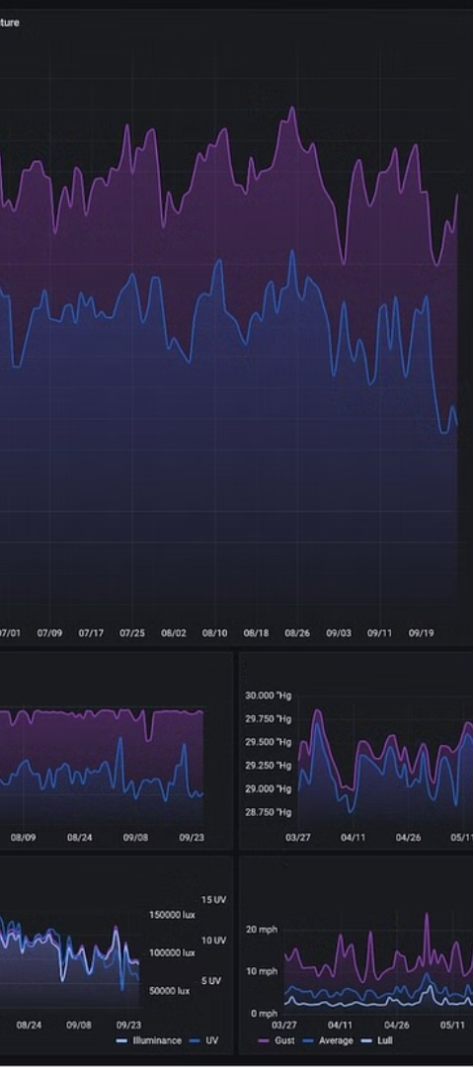
Methodology
1
Call the OpenWeatherMap API
Receive data in real-time from the OpenWeatherMap database to display various parameters of the weather
2
Segregating Data :
Gathering the data of each parameter separately to display it in plots and graphs. Such as Line chart, Dot plot etc.
3
Create an Interactive Graphical User Interface
Using the R Shiny Package, create a plot for each parameter of the weather and its respective statistics

Slide 6
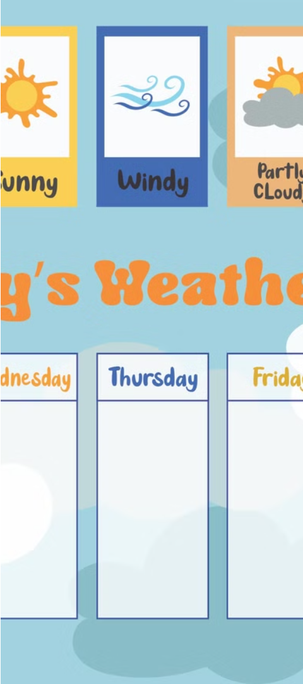
Dive Deeper into the Methodology
4
Display a Map
Implementing the leaflet package by showing the world map and storing the coordinates of the place that the user clicks on
5
Creating Recommendations
Depending on the current and historical weather patterns, Providing the user a suggestion about the current weather situation
6
Visibility
Merging the entire project together on a local server and displaying the data to the user

Slide 7
RESULTS:

Slide 8
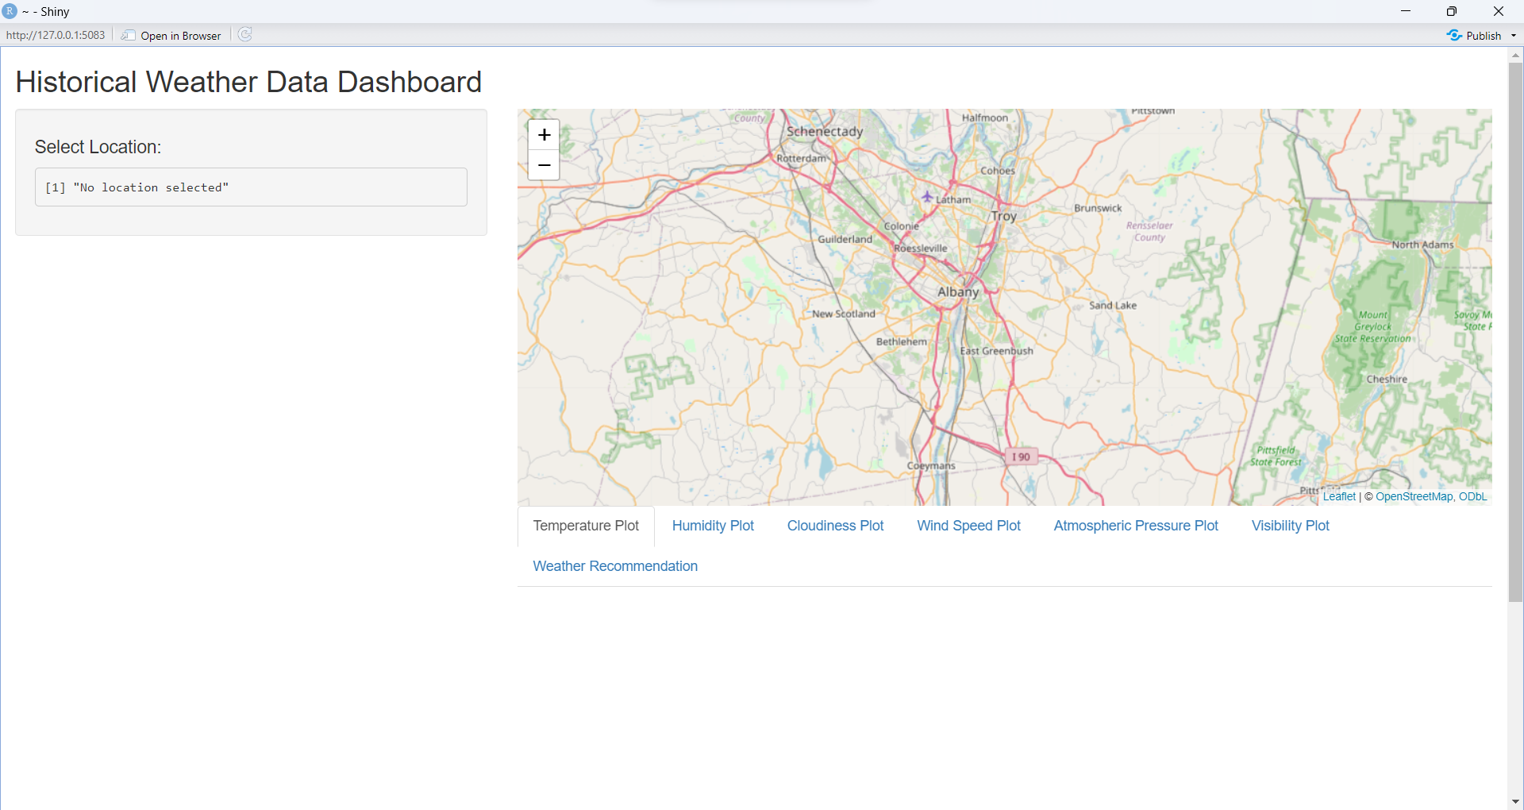
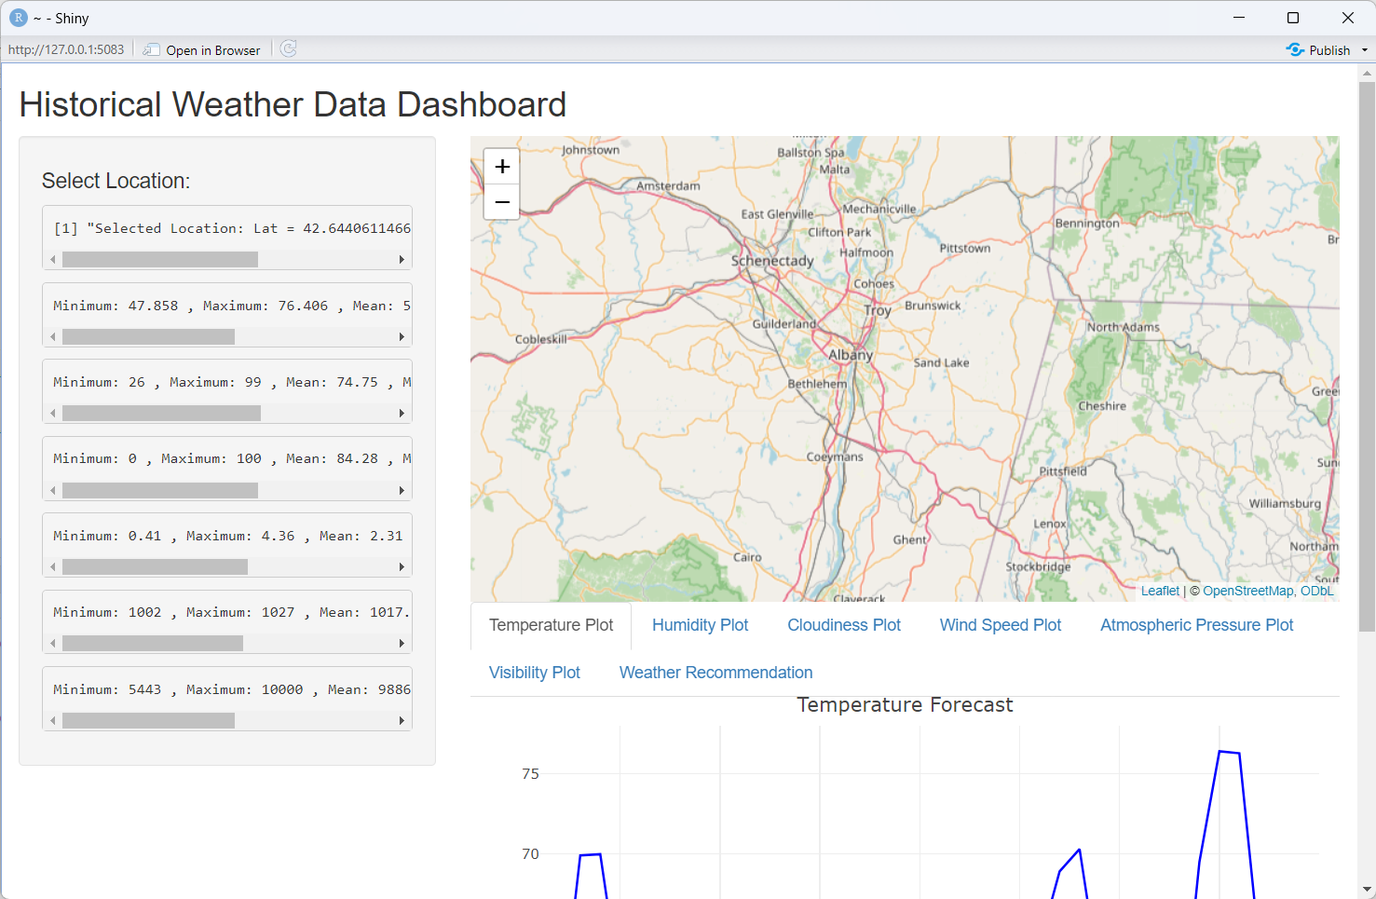
2. DISPLAYING MAP
1. ON STARTUP

Slide 9
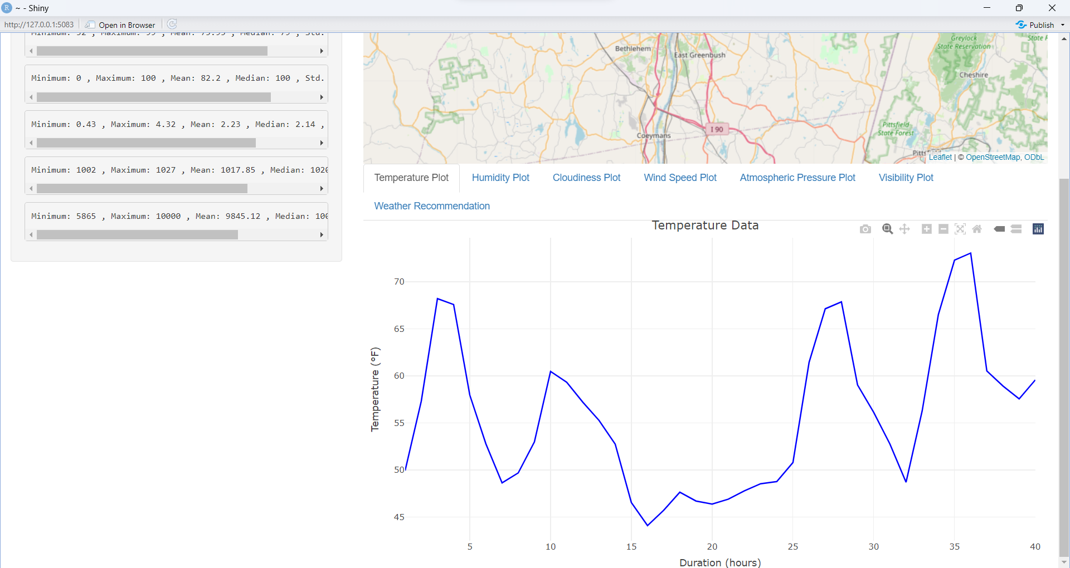
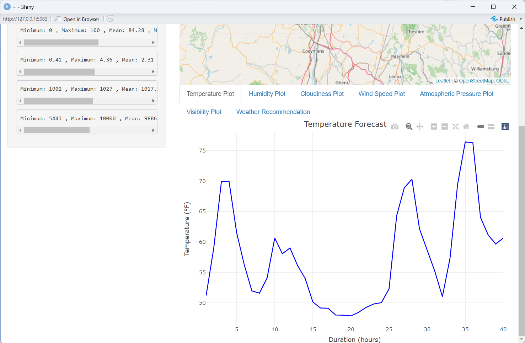
4. DISPLAYING STATS
1. ON STARTUP
3. DISPLAYING TEMP DATA

Slide 10
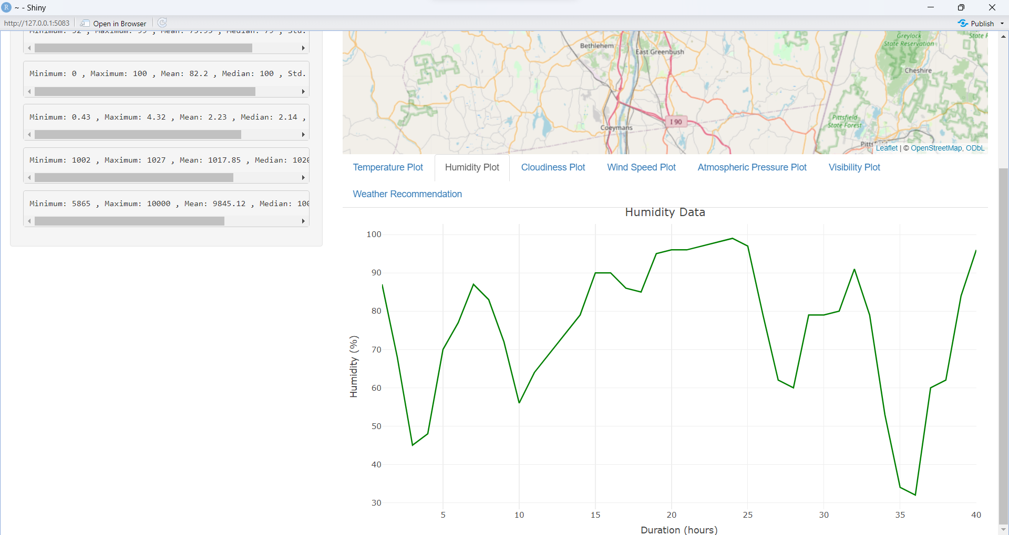
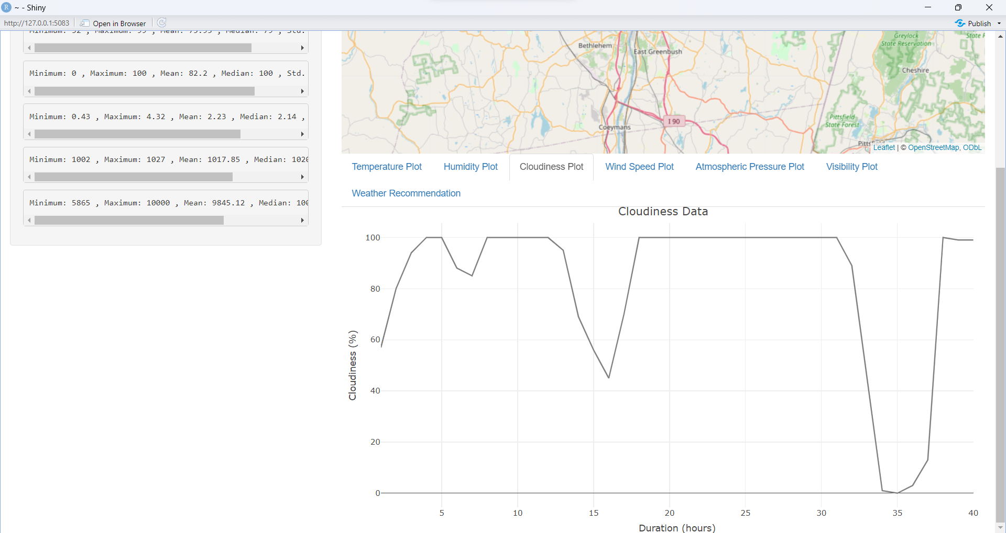
6 . DISPLAYING CLOUDLINESS DATA
5 . DISPLAYING HUMIDITY DATA

Slide 11
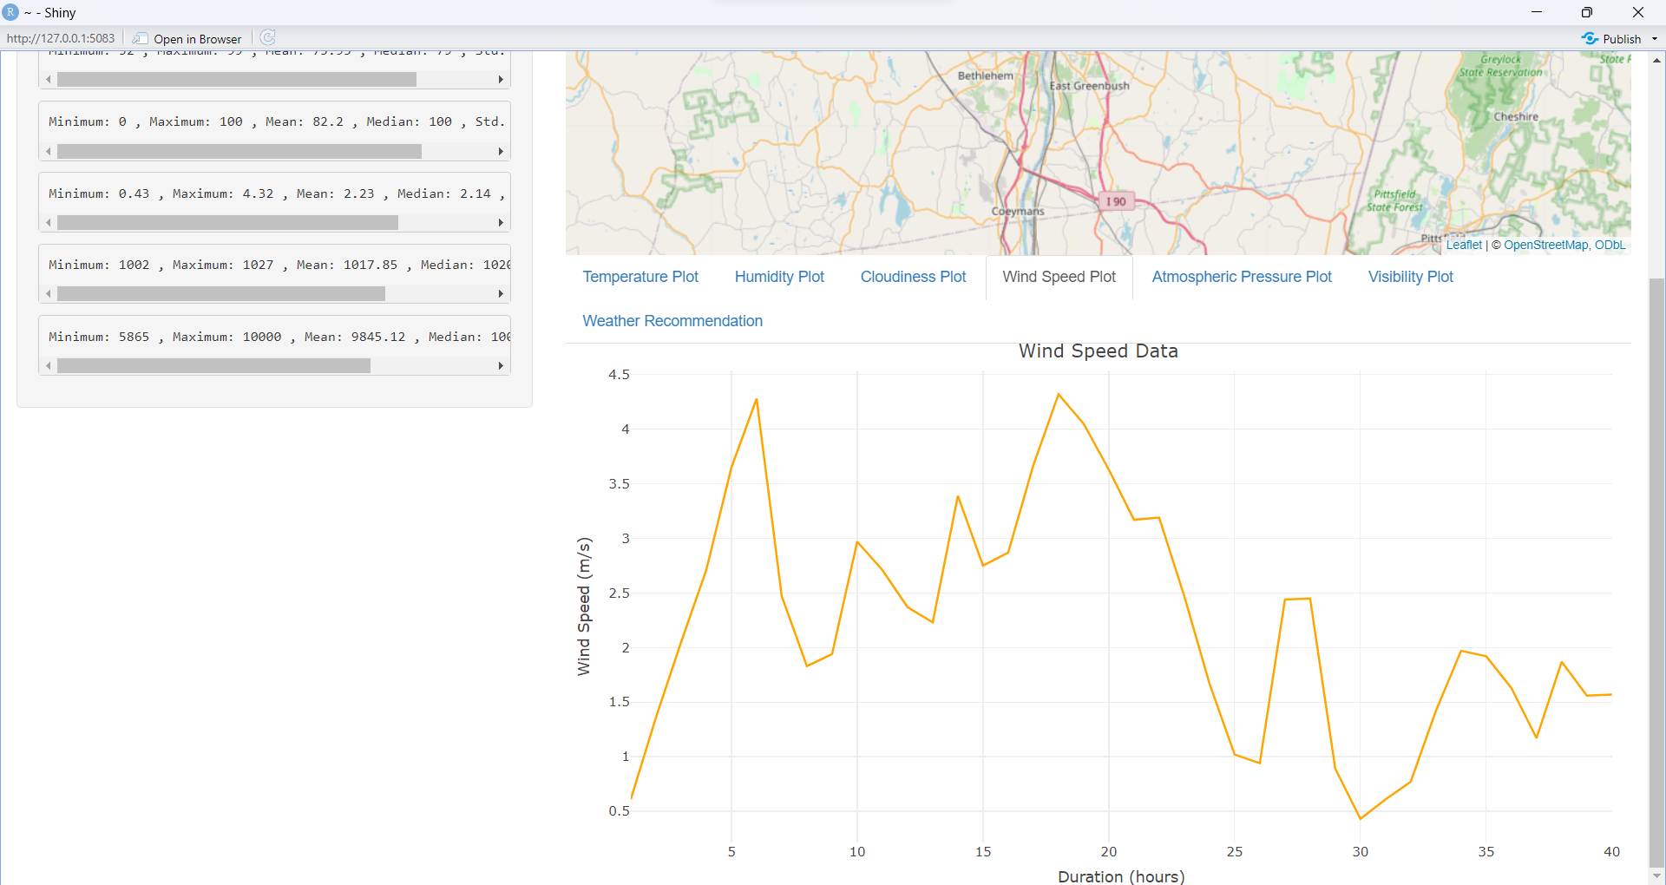
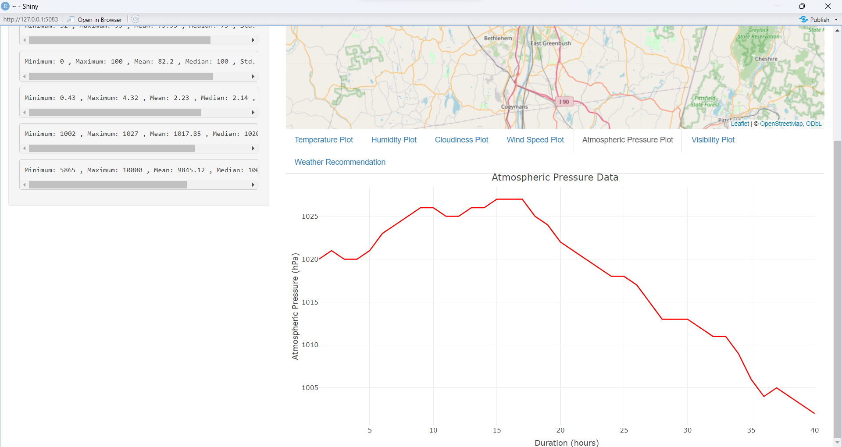
8. DISPLAYING ATMOSPHERIC PRESSURE DATA
7. DISPLAYING WIND SPEED DATA

Slide 12
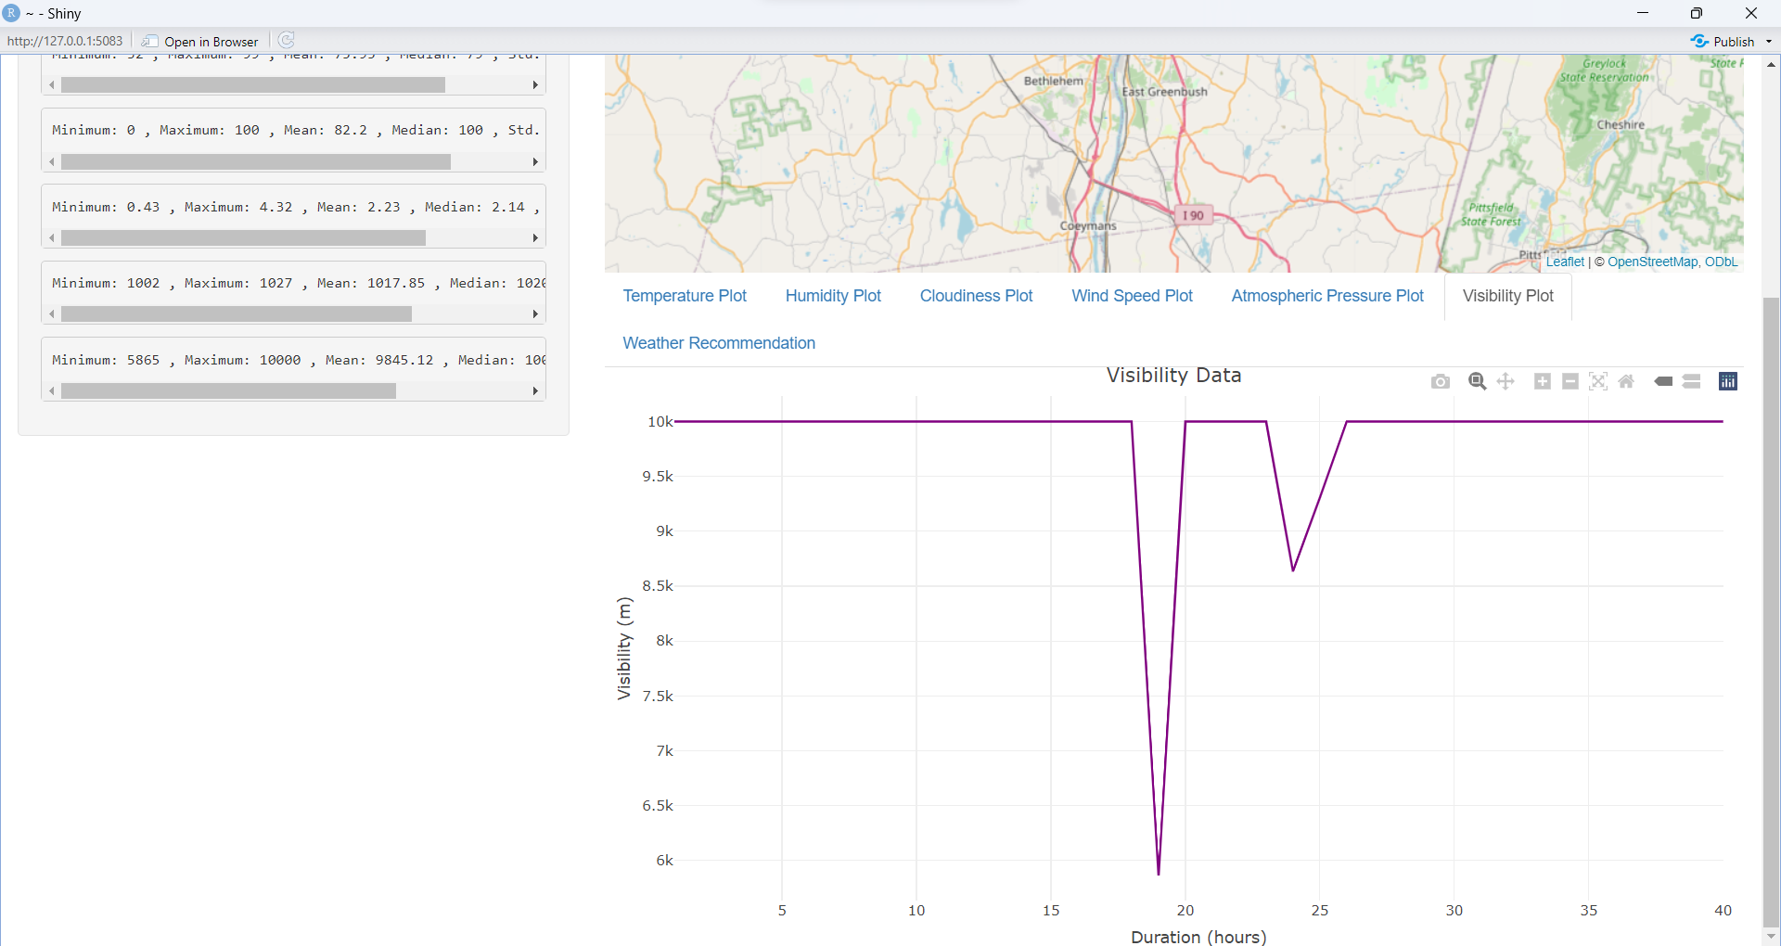
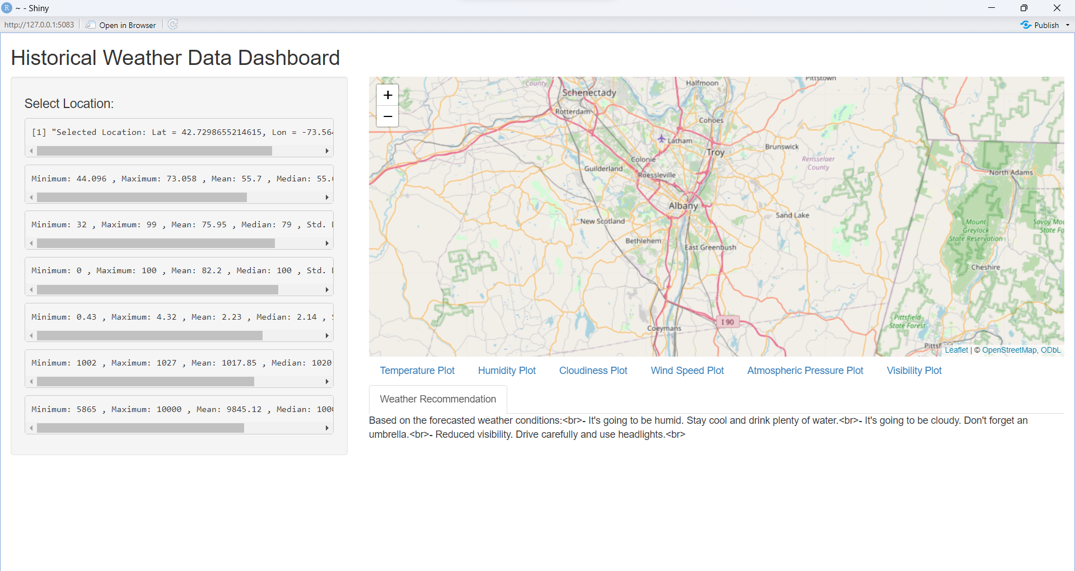
10. DISPLAYING WEATHER RECOMMENDATIONS
9. DISPLAYING VISIBILITY DATA

Slide 13
CONCLUSION:

Slide 14
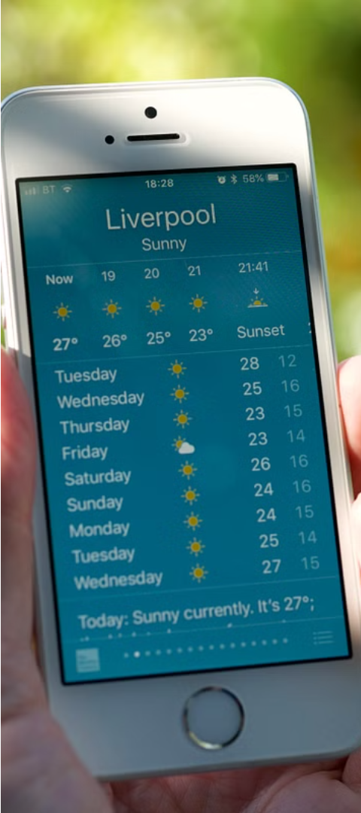
Empowering Decision-Making with Weather Insights
Plan Outdoor Activities
Prepare for Severe Weather
The app's weather data and personalized recommendations can help users plan their outdoor activities, such as picnics, sporting events, or hiking trips, by providing insights into the optimal weather conditions for their chosen activities.
By monitoring the weather data, users can better prepare for potential severe weather events, such as storms, heavy rainfall, or extreme temperatures, allowing them to take necessary precautions and mitigate any associated risks.
Optimize Travel Plans
The app's ability to provide weather data for various locations can assist users in optimizing their travel plans, ensuring they are equipped for the weather conditions at their destination and can make informed decisions about transportation, packing, and other travel-related considerations.

Slide 15
Unlocking the Power of Historical Weather Data
Understanding Past Patterns
Significance for Various Domains
Comprehensive Dashboard
Informed Decision-Making
The historical weather data dashboard provides users with an intuitive interface to explore and analyze past weather patterns. It offers a range of features to customize the data visualization and gain deep insights.
By analyzing historical weather data, we can gain valuable insights into past weather patterns, trends, and anomalies. This knowledge can inform better planning, risk management, and decision-making across various sectors.
Weather plays a crucial role in agriculture, transportation, tourism, and outdoor activities. Accessing historical weather data empowers users to make informed choices and optimize their plans based on past weather conditions.
Leveraging the insights from historical weather data, users can make better-informed decisions for their personal and professional needs, from planning outdoor activities to optimizing travel plans and managing weather-related risks.

Slide 16
Comprehensive Weather Data at Your Fingertips
Weather Parameter
Summary Statistics
Temperature
Min: -5°C, Max: 25°C, Average: 15°C
Humidity
Min: 30%, Max: 90%, Average: 60%
Cloudiness
Min: 0%, Max: 100%, Average: 50%
Wind Speed
Min: 0 m/s, Max: 20 m/s, Average: 5 m/s
Atmospheric Pressure
Min: 980 hPa, Max: 1020 hPa, Average: 1000 hPa
Visibility
Min: 500 m, Max: 10000 m, Average: 5000 m

Slide 17
TOOLS:
R STUDIO for developing the data dashboard
OpenWeatherMap API for the real time historical data

Slide 18

This Photo by Unknown Author is licensed under CC BY-SA

